Slide 1

INTRODUCTION
CUSTOMER REVENUE AND TRANSACTION INTELLIGENCE SYSTEM

Slide 2
BUSINESS REQUIREMENT
Objective
Data Walkthrough & Quality Check in Power Query(Excel)
Data Connection using ETL Process
Data cleansing, sorting, filtering and analyzing data in SQL
Writing Queries in Postgre SQL
Data Modelling and Processing
DAX Calculations in Power BI
Dashboard Lay outing
Insights Generation
Dashboard

Slide 3
OBJECTIVE
To provide a comprehensive analysis of credit card usage patterns, customer demographics, and revenue generation segmented by key variables such as gender, age group, income level, education level, and expenditure type.
To enable data-driven decision-making by presenting actionable insights into customer behavior, transaction trends, and financial metrics across different card categories and customer segments.

Slide 4
DASHBOARD -1 CREDIT CARD CUSTOMER REPORT

Slide 5
DASHBOARD SPECIFICATION
KPI’s Requirements :
Total Revenue (55.4M):
Indicates the overall income generated from credit card customers.
Total Interest (7.9M):
Reflects the total interest earnings from credit card holders.
Total Income (577M):
Includes combined revenue streams such as transactions, fees, and interest.
CSS (3.19):
Likely a calculated customer satisfaction score or a ratio indicating credit card usage effectiveness.

Slide 6
CHART REQUIREMENTS
Revenue vs Gender Line Chart:
Compares revenue trends between male and female customers over months in 2023.
Helps in identifying which gender contributes more consistently to revenue.
Age Group Bar Chart:
Displays revenue distribution among different age groups (e.g., 20-30, 30-40).
Assesses which age segment contributes most to revenue.
Top 5 States Horizontal Bar Chart:
Highlights states (e.g., TX, NY, CA) with the highest revenue generation.
Provides regional insights into customer contribution.
Salary Group Horizontal Bar Chart:
Revenue split by salary brackets (low, mid, high).
Identifies how income levels impact card usage and revenue.

Slide 7
CHART REQUIREMENTS
Dependent Count Bar Chart:
Shows revenue based on customers' dependent counts (e.g., 4, 3, 2).
Highlights spending patterns related to family size.
Marital Status Bar Chart:
Revenue comparison by marital status (Married, Single, Unknown).
Provides insights into spending trends based on relationship status.
Education Level Bar Chart:
Revenue analysis by education levels (Graduate, High School, College).
Highlights the education segment generating the most revenue.

Slide 8
ANALYSIS & FINDINGS
Revenue Trends:
Males contribute slightly more to revenue compared to females, with fluctuations in revenue across months.
Age Group Insights:
Customers aged 40-50 generate the highest revenue, followed by 50-60 age group.
Regional Revenue:
Texas (TX) leads in revenue generation among states, followed by California (CA) and New York (NY).
Salary Insights:
Higher salary groups contribute the most revenue, indicating a direct correlation between income and spending.
Dependents Influence:
Customers with 2-3 dependents show higher revenue contribution.
Marital Status:
Married customers contribute more revenue than single or unknown status groups.
Educational Impact:
Graduates generate the highest revenue, while postgraduates and doctorate holders contribute the least.
Customer Distribution:
The dashboard highlights a balance between high and mid-level revenue contributors, emphasizing diversity in customer demographics.

Slide 9
RECOMMENDATIONS
Target High Revenue Age Groups:
Focus marketing efforts on the 40-50 and 50-60 age groups, as they generate the highest revenue.
Engage High-Salary Groups:
Offer premium services and benefits to customers in the high salary group to enhance loyalty and spending.
Leverage Regional Insights:
Prioritize Texas, New York, and California for campaigns, as they contribute significantly to revenue.
Tailor Products for Dependents:
Develop family-oriented credit card benefits to attract customers with 2-3 dependents.
Focus on Married Customers:
Introduce rewards or special offers tailored for married customers, who contribute more revenue.
Enhance Graduate Engagement:
Provide exclusive offers or loyalty programs for graduates to sustain their contribution.
Gender-Specific Campaigns:
Create gender-specific promotions to boost revenue from both male and female customer segments.
Improve Low-Segment Participation:
Identify strategies to increase engagement from low-salary and lower-contributing education levels.

Slide 10
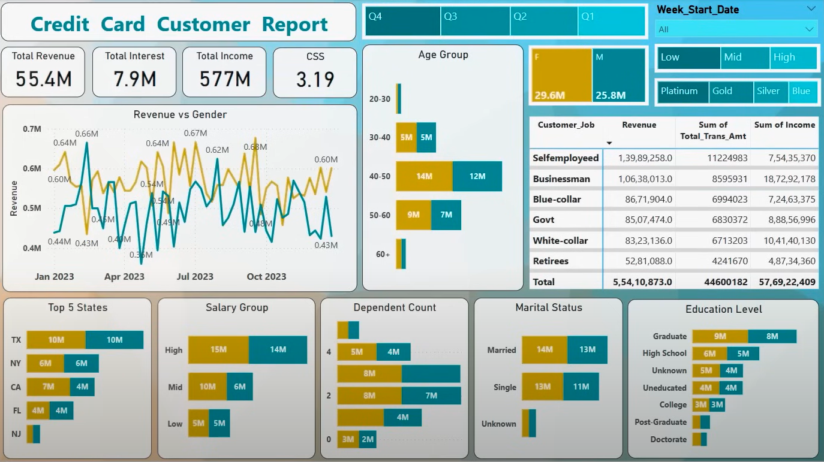
DASHBOARD

Slide 11
DASHBOARD - 2 CREDIT CARD TRANSACTION REPORT

Slide 12
CHART REQUIREMENTS
Dashboard 2 : Credit Card Transaction Report:
Quarterly Revenue & Transaction Count:
A combined bar and line chart representing revenue and transaction count per quarter (Q1 to Q4).
Monitors seasonal trends in credit card usage.
Revenue by Expenditure Type Horizontal Bar Chart:
Shows spending distribution across categories (Bills, Entertainment, Fuel).
Analyzes which expenditure types drive the most revenue.
Revenue by Education Level Bar Chart:
Similar to Dashboard 1, displays revenue based on education segments.
Revenue by Customer Job Horizontal Bar Chart:
Breaks down revenue by professions (e.g., Businessman, Govt, Blue-collar).
Provides insights into job-specific spending patterns.

Slide 13
CHART REQUIREMENTS
Revenue by Use (Swipe, Chip, Online):
Highlights revenue contributions based on transaction methods.
Identifies popular payment methods.
Customer Acquisition Cost (CAC) by Card Category:
Bar chart indicating the cost of acquiring customers per card type (Blue, Silver, Gold, Platinum).
Helps in evaluating cost efficiency of card acquisition campaigns.

Slide 14
ANALYSIS & FINDINGS
Revenue and Transactions:
Q3 generated the highest revenue and transaction count among all quarters.
Card Categories:
Blue and Silver card categories contribute the most revenue, while Platinum cards generate the least.
Expenditure Type:
Bills and entertainment are the highest expenditure categories, followed by fuel and groceries.
Education Influence:
Graduates contribute the highest revenue compared to other education levels.
Customer Jobs:
Self-employed customers contribute the most revenue, followed by businessmen and blue-collar workers.
Usage Type:
Swipe transactions account for the majority of revenue, followed by chip transactions and online payments.
Customer Acquisition Cost:
Blue cards have the highest acquisition cost, while Platinum cards have the lowest.

Slide 15
RECOMMENDATIONS
Focus on High-Contributing Segments:
Target graduates, self-employed individuals, and businessmen for customized offers to boost revenue.
Enhance Card Categories:
Promote Silver and Platinum cards with tailored rewards to increase their adoption and revenue share.
Optimize Transaction Channels:
Encourage chip and online payment usage through rewards or discounts to balance transaction modes.
Increase Spend on High Categories:
Introduce incentives for bills, entertainment, and grocery expenses to drive higher spending.
Cost Efficiency:
Reduce acquisition costs for Blue cards by refining marketing strategies and focusing on high-value customers.
Seasonal Campaigns:
Leverage Q3 trends to implement targeted campaigns during high-revenue periods.

Slide 16
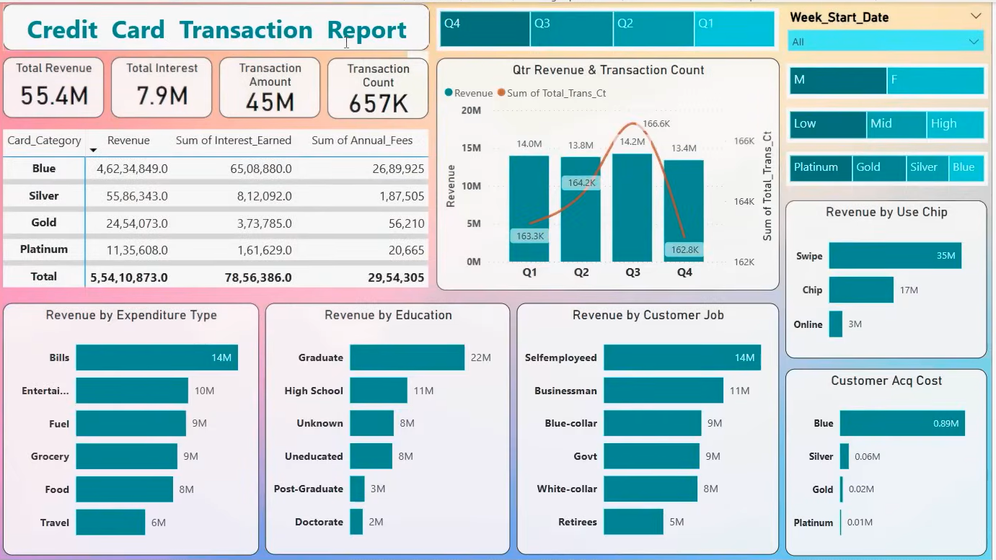
DASHBOARD

Slide 17
THANK YOU

